Slide 1
Introduction to Unit Test
Authors: LanBT & ThuyNT

Slide 2
Contents
  Unit Test Fundamentals: Answer the question of what, why, when doing the Unit Test
  Methodologies to do Unit Test
  Unit Testing Tools
      CUnit/ CPPUnit Framework
      Parasoft C++ Test 6.7

Slide 3
What is UniTest
“Unit testing” refers to testing software code at the smallest testable unit (method or function) and based on detail design
Exception testing
    Range of feasible input
Functional testing
    Conform to specification
    Black Box Testing
    White Box testing
Regression testing
    Conducted after a change
    To find new fault

Slide 4
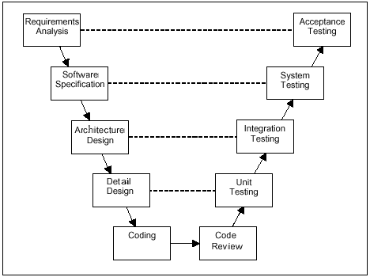
When do Unit Test

Slide 5
Why do Unit Test
  Ensure quality of software unit
  Detect defects and issues early
  Reduce the Quality Effort & Correction Cost

Slide 6
Unit Test - Methodologies
To implement 1 software testing, we use both:
Black box Test
White box Test

Slide 7
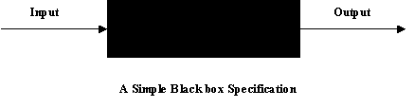
Back box testing
Based on external behavior of the unit tested
Specification based testing
Strategies
  Equivalence partitioning
  Boundary-value analysis
  Combination strategy

Slide 8

White box testing (1)
Based on internal behavior of unit
Code coverage based testing
Criteria
  Statement coverage
  Decision coverage
  Path coverage

Slide 9
White box testing (2)
int Func(int a,int b)
{
if (a > 0)
if( b > 0)
return(a+b);
else
return(a-b);
else
return 0;
}
6 statements: 1,2,3,4,5,6
4 decisions(branchs):2→6, 2→3, 3→4, 3→5
3 paths: 1 – 2 – 6, 1 – 2 – 3 – 4,1 – 2 – 3 – 5
Ex:Test case: a =1, b = 1 has SC = 4/6, PC = 1/3, DC = 2/4
1
1
2
2
3
4
6
3
5
6
4
5

Slide 10
Cunit Framework
Cunit is used to test C code units
Using Steps:
  Write functions for tests
  Initialize the test registry
  Add suites to the test registry
  Add tests to the suites
  Run tests using an appropriate interface
  Cleanup the test registry

Slide 11
CPPUnit Framework
Used to test C/C++ code units
Using Steps
  Create your class
  Create your new testing class deriving from TestFixture class
  Create the event manager and test controller
  Add a listener that colllects test result
  Add a listener that print dots as test run
  Add the top suite to the test runner
  Print test in a compiler compatible format

Slide 12
Parasoft C++ test
Give automated – creating test case testing for C/C++ units (functions, methods)
Source Unit testing
Native Unit testing
Test case Results
Stub configuration

Slide 13


